Slide 1


THE LEGAL FICTION OF THE REPUBLIC
Marianne, Her Brazilian Sister and the Transnational Allegory of the State
ANA VANZIN

Slide 2

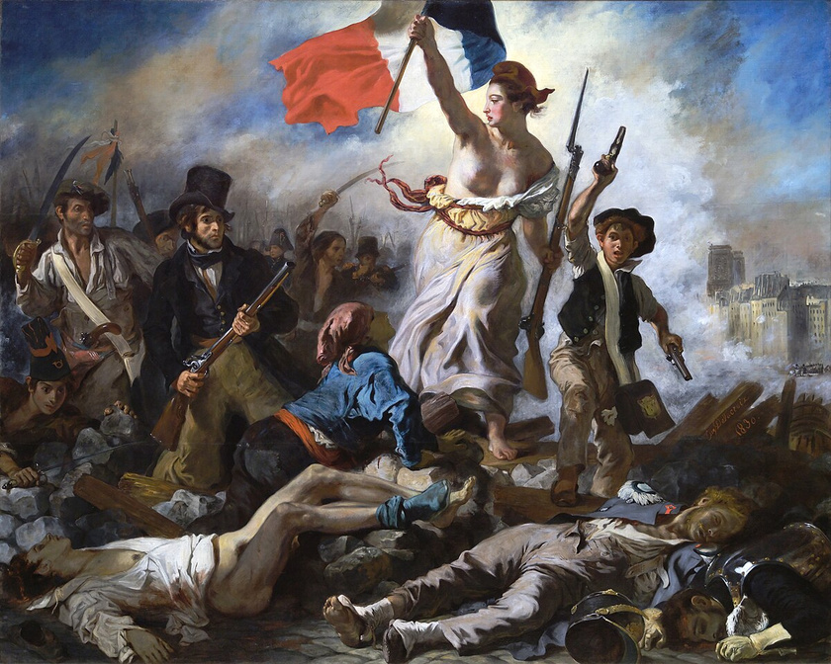
THE LEGAL FICTION OF THE REPUBLIC
In Delacroix’s composition, the female figure represents an allegorized abstraction of the Republic itself.
Marianne, leading the people, exemplifies how the modern State renders its authority legible through a gendered and idealized body — a juridical fiction mobilized to naturalize the aesthetic of sovereignty.
Delacroix’s Liberty Leading the People

Slide 3
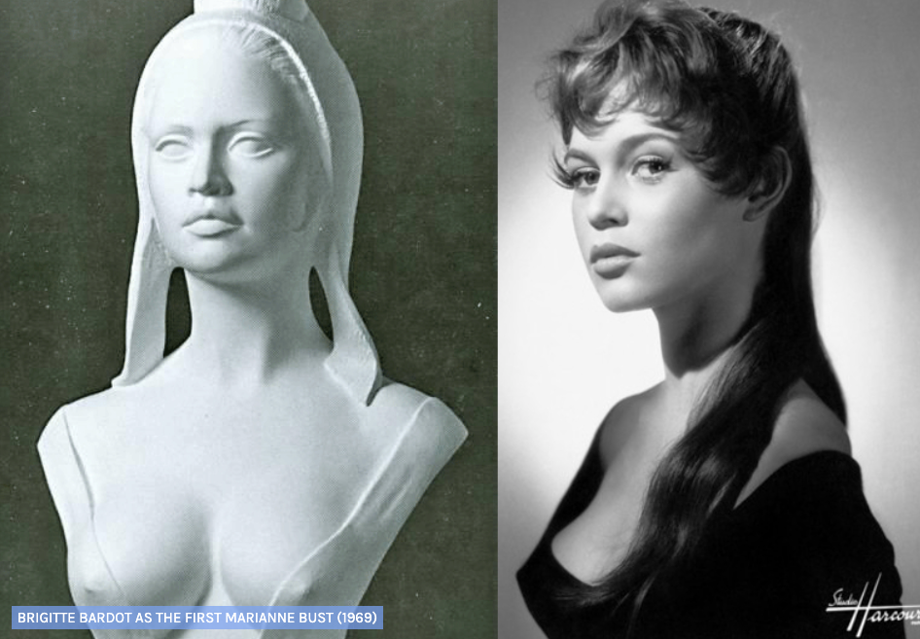
FROM ABSTRACTION TO CELEBRITY: BARDOT AS MARIANNE

Slide 4
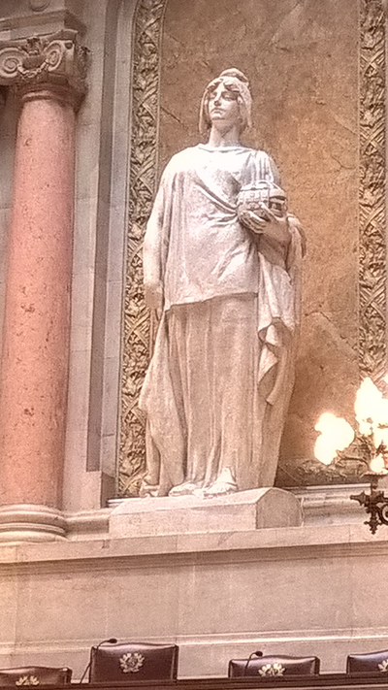
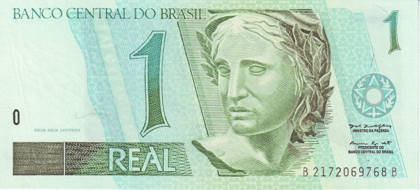
WHO'S THAT WOMAN ON OUR MONEY?
In Brazil, Marianne's sister: the allegorical Republic drawn from Villares’s 1919 bust.
She circulates on banknotes.

Slide 5
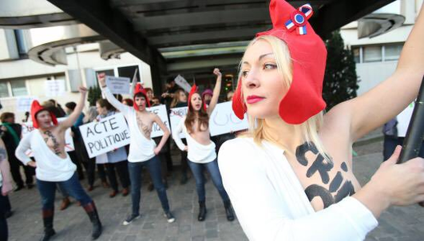


FEMEN: WHEN FICTION WALKS
In 2013, Inna Shevchenko re-performed Marianne — not as symbol, but as protest.

Slide 6
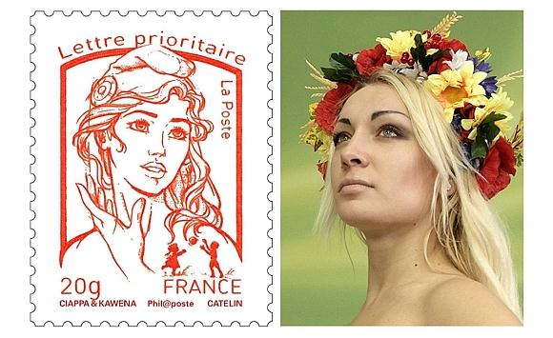
THE SAME BODY ONCE ARRESTED FOR BECOMING MARIANNE WAS LATER CHOSEN TO PRINTED AS HER ON A NATIONAL STAMP.

Slide 7
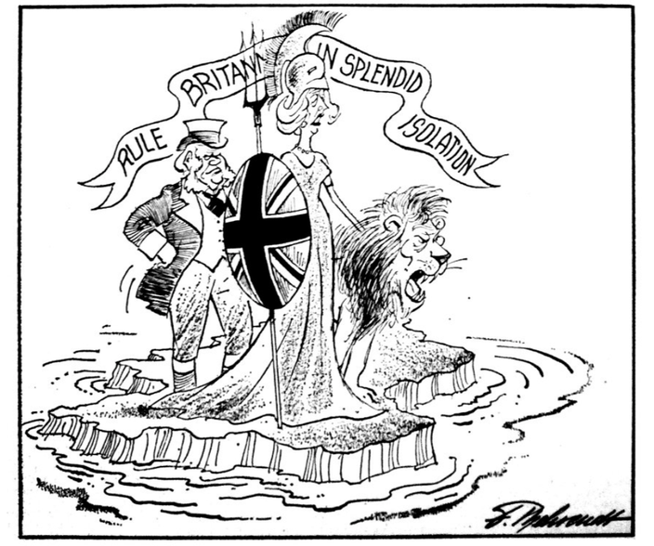
BRITANNIA AND THE REVERSAL OF POWER
Allegory cuts both ways: Britannia and Margaret Thatcher

Slide 8
PANOFSKY’S METHOD
  The pre-iconographic level registers what we see: a classically dressed woman.
  The iconographic level decodes the symbol: this woman stands for Marianne, for República, for Britannia — for the State imagined in feminine form.
  The iconological level, we uncover the political operation: these images stabilize republican authority through a gendered aesthetic.
THE FEMININE FIGURE LEGITIMIZES POWER BY MAKING IT APPEAR TIMELESS, HARMONIOUS, AND VIRTUOUS. THIS IS THE LEVEL AT WHICH ALLEGORY FUNCTIONS AS ART, BUT ALSO AS A VISUAL FORM OF LAW.

Slide 9
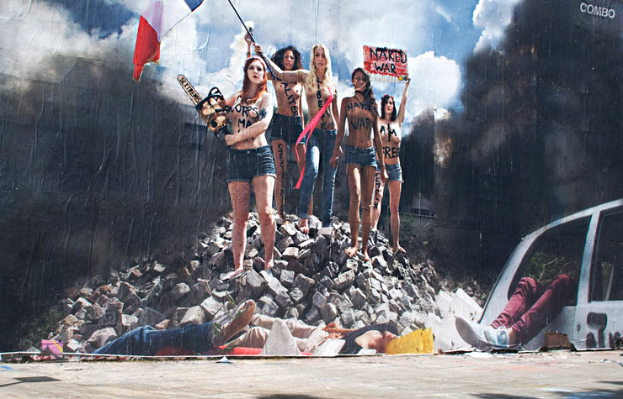

Slide 10



PERHAPS THE REPUBLIC WAS NEVER SCULPTED IN MARBLE.
PERHAPS IT WAS ALWAYS WRITTEN ON SKIN.

